Slide 1


ShopEZ: A Full-Stack E-commerce Application
This presentation showcases the ShopEZ e-commerce platform, a comprehensive full-stack application built with the MERN stack (MongoDB, Express.js, React.js, Node.js). ShopEZ offers a streamlined, user-friendly platform for online shopping, incorporating features for product browsing, secure checkout, and order tracking.

Slide 2
Team and Project Overview
Team Members
Project Goals
Sabari Sriram V - Frontend Developer & Team Lead
ShopEZ aims to provide a comprehensive e-commerce experience for users. The platform facilitates product browsing, secure checkout, and order tracking, with a focus on user-friendliness and efficiency.
Mugeshwaran B - Backend Developer
Ruhasan J - Database Manager
Ravishankar Kumar - Frontend Developer
Saddam Hussain - Quality Assurance & Documentation

Slide 3
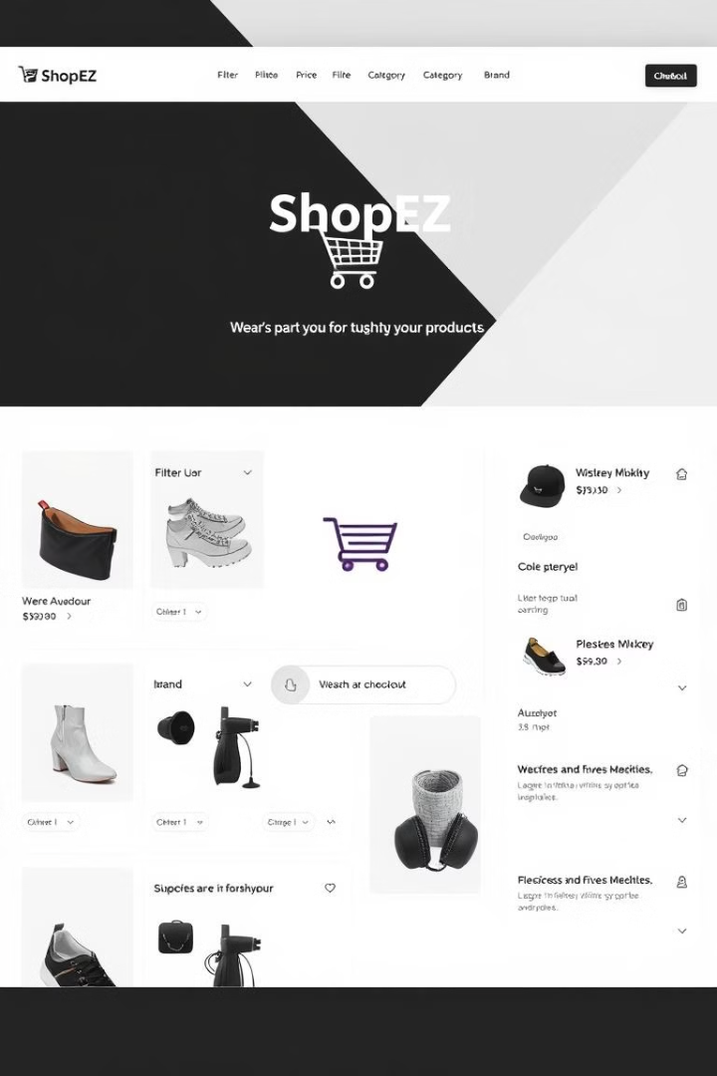
Core Features
User Authentication
Product Browsing & Filtering
Users can create accounts to save preferences, view past orders, and track current orders.
Users can browse products by category, use filters for quick searching, and view product details.
Shopping Cart & Checkout
Users can add items to their cart, manage quantities, and proceed through a secure checkout process.

Slide 4

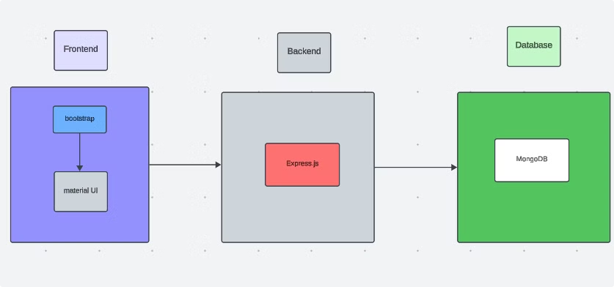
Technical Architecture
ShopEZ's architecture is built upon the MERN stack, utilizing each technology's strengths for a robust and scalable platform.

Slide 5


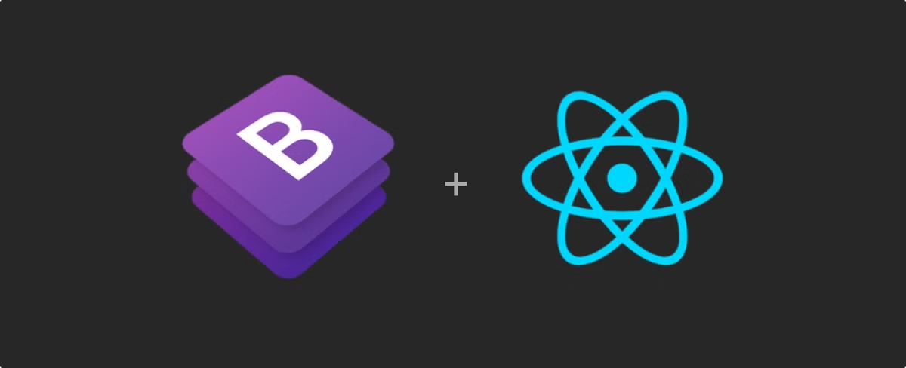


Frontend Development
React.js
React.js powers the dynamic user interface, providing a responsive and engaging shopping experience. It's used for creating reusable UI elements, enhancing efficiency and user experience.
Axios
Axios is used to make API calls to the backend, facilitating seamless communication between the frontend and backend for data retrieval and updates.
Bootstrap & Material UI
These frameworks enhance the visual appeal and usability of the application, ensuring a consistent and user-friendly design across all devices.

Slide 6



Backend Development
Express.js
1
Express.js, a Node.js framework, serves as the backend, handling server-side logic, API endpoints, and processing requests from the frontend.
MongoDB
2
MongoDB, a flexible NoSQL database, stores data including user information, product details, and order history, ensuring efficient data management.
Mongoose
3
Mongoose simplifies interactions with MongoDB, providing an Object-Document Mapping layer for CRUD operations.

Slide 7

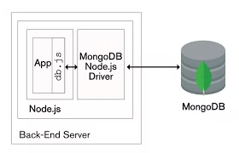
Project Setup & Installation
1
Prerequisites
Node.js, npm, MongoDB, Git, and a code editor are essential for development. Ensure these tools are installed on your system.
2
Dependencies
Install project dependencies for both frontend and backend using npm install commands.
3
Start Development Servers
Launch both frontend and backend servers using npm start commands. The frontend server will run on http://localhost:3000 and the backend on http://localhost:5000.

Slide 8
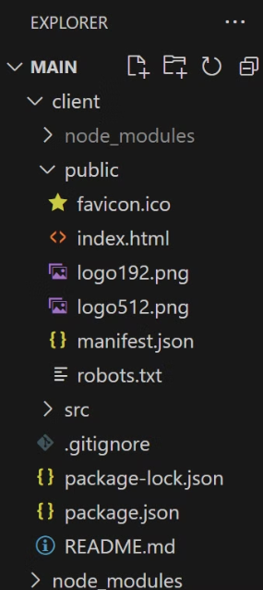
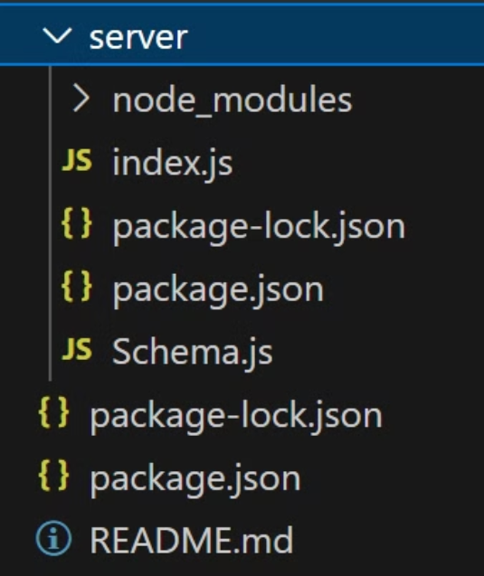
Project Folder Structure
Client Directory
Server Directory
The project is organized into client and server directories, each containing relevant code for their respective components. The frontend code is housed in the client directory while the backend code resides in the server directory.

Slide 9
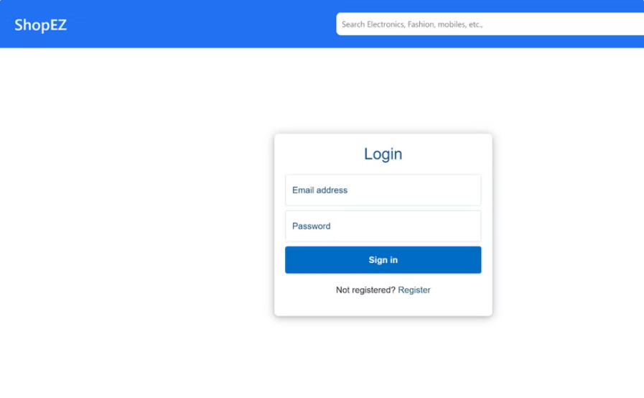
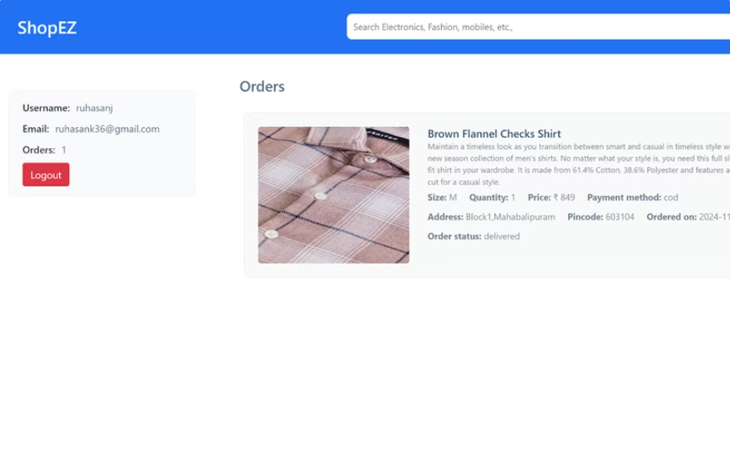
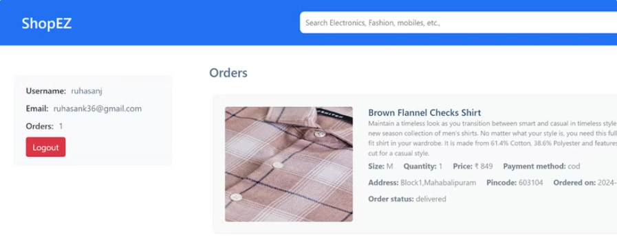
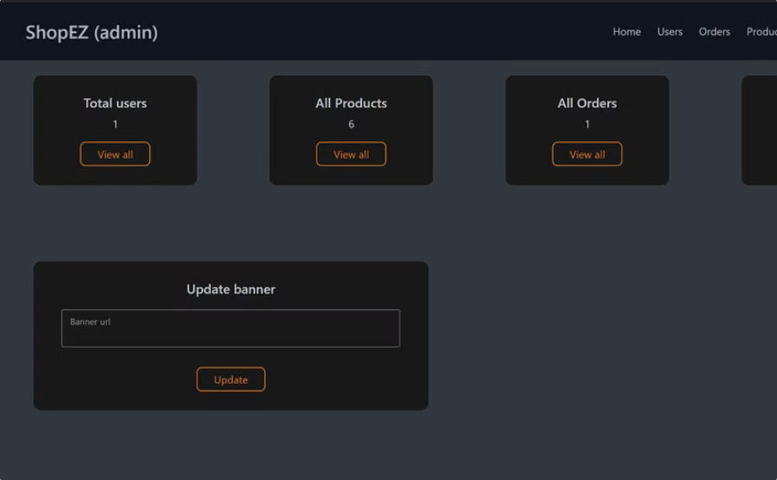

User Interface Design
Login Page
Home Page
Users can log in with their registered credentials to access their accounts.
Welcomes users with featured products, product categories, and promotional banners.
Cart Page
Admin Dashboard
Displays items added by the user, along with the ability to modify quantities or remove products.
Allows platform administrators to manage users, orders, and products, providing a comprehensive overview of the system's operations.
ShopEZ's UI is designed with a focus on user-friendliness, offering intuitive navigation, clear information, and a visually appealing layout.

Slide 10





Future Enhancements
AI-Powered Recommendations
Integrating AI algorithms for personalized product recommendations based on user behavior.
Enhanced Order Tracking
Offering real-time, detailed order tracking with notifications at key stages.
Chatbots for Support
Introducing AI-driven chatbots for real-time customer support.
Multi-Language & Currency
Implementing support for multiple languages and currencies to expand global reach.

